Slide 1

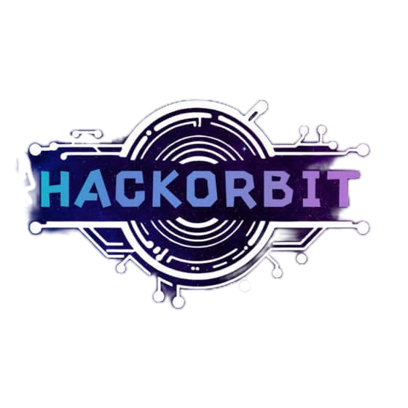



HackOrbit 2025
Team Ideonova

Slide 2


THEME & PROBLEM STATEMENT
Problem: Many struggle with scattered health data and medication adherence. The challenge? Lack of unified, AI-driven platforms for personalized insights
Fragmented Data
Difficulty managing and understanding diverse health records.
Poor Adherence
Missed medications and delayed treatments.
Lack of Support
No accessible platform for personalized analytics and AI guidance.

Slide 3
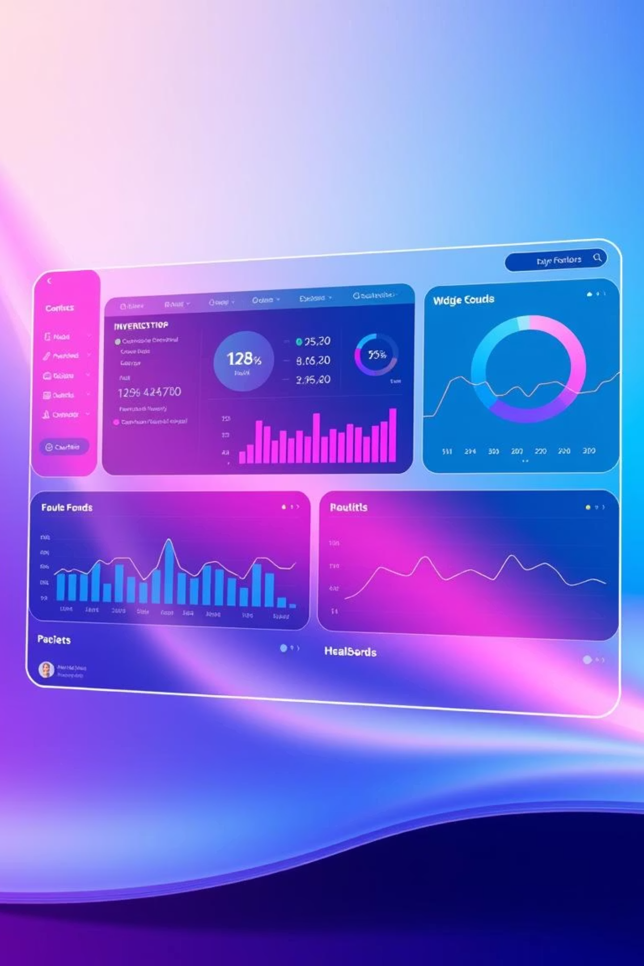



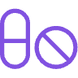
PROPOSED SOLUTION
MediMind : A web-based healthcare portal for seamless health data management and
AI support.
Effortless Uploads
Upload PDFs, images for automatic data extraction and analysis.
Visual Analytics
Compare results with standard thresholds for easy interpretation.
AI Chatbot
Instant assistance for general medical queries.
Pill Reminders
Customizable notifications for medication adherence.

Slide 4
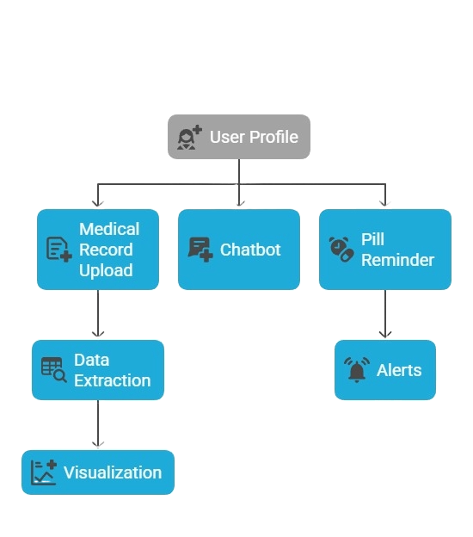
FLOWCHART

Slide 5
FLOWCHART EXPLANATION
🔹 User Profile
Acts as the central hub for personalized healthcare access.
🔹 Medical Record Upload
Allows users to upload prescriptions and reports.
➤ Data Extraction: Automatically extracts health metrics.
➤ Visualization: Displays health trends via graphs and charts.
🔹 Chatbot
AI-powered assistant for answering health-related queries.
Helps interpret reports and navigate the app.
🔹 Pill Reminder
Users can schedule medication reminders.
➤ Alerts: Sends timely notifications to ensure medication adherence.

Slide 6
FEATURES AND NOVELTY
Innovative functionalities that set MediMind apart are:
📁 Personal Health Dashboard
⏰ Pill Reminder System
Track and visualize health record data over time with intuitive charts.
Never miss a dose with smart, customizable alerts via various channels.
🤖 AI Chatbot Integration
🧠 Data Visualization
Get real-time, AI-powered answers to health-related queries, available 24/7.
Easy-to-understand charts compare your data with medical norms.

Slide 7
DRAWBACK AND SHOWSTOPPERS
Acknowledging challenges and ensuring robust solutions :
AI Chatbot Accuracy: Requires continuous updates for medical accuracy.
OCR/NLP Limitations: Potential struggles with handwritten or poorly scanned documents.
Data Privacy & Compliance: Essential adherence to regulations like HIPAA and GDPR.
Accessibility Needs: Requires internet access and basic digital literacy.

Slide 8
TEAM IDEONOVA
Meet the dedicated minds behind MediMind:
1
Arathi Mohan - arathimohan54@gmail.com
2
Archa Satheish - satheisharcha3@gmail.com
3
Athul Zacharia Alex - athulzachariaalex@gmail.com
4
Neha P S - nehaputhan@gmail.com

Slide 9
Thank you

